Slide 1

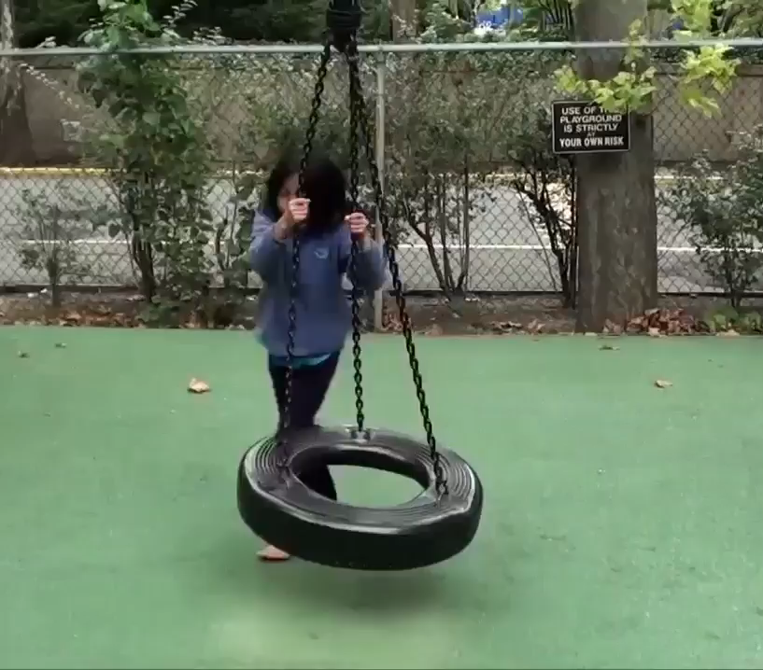
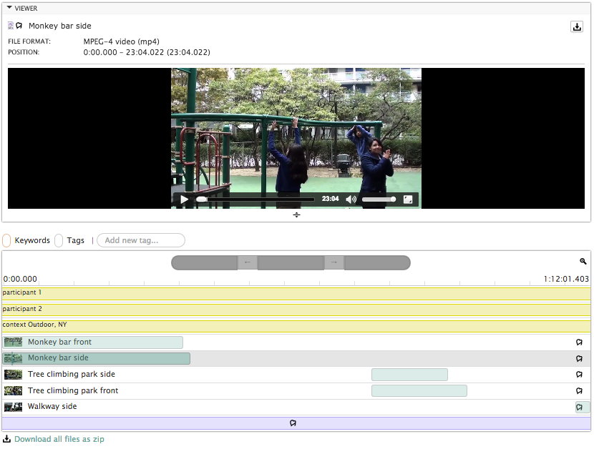
Databrary:
Sharing and
Reusing Video Data
Notes:
So, let me start by talking abt behav

Slide 2
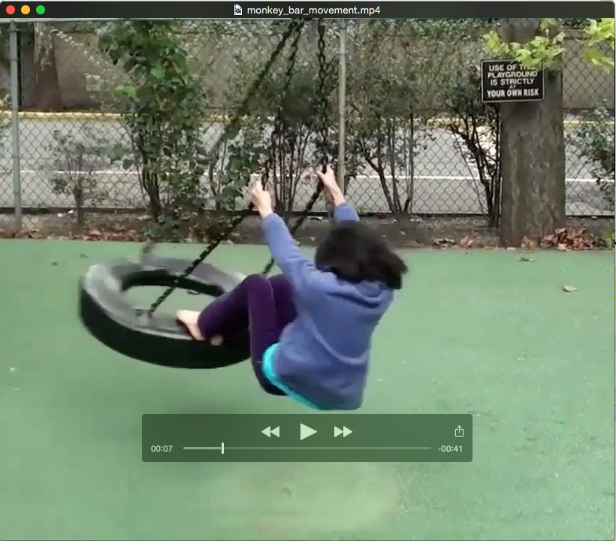
Databrary:
Sharing and
Reusing Video Data
Notes:
So, let me start by talking abt behav

Slide 3
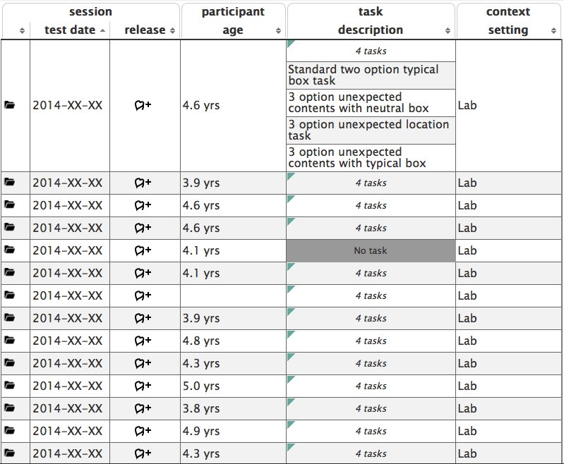

Databrary:
Upload As You Go
Active workspace for researchers
Tools map to existing practices
Enforces standardized metadata
Notes:
So, let me start by talking abt behav

